Slide 1
Rubber plantation
Climatic requirements for rubber
Rubber grows well in well drained porous soils which are moderate to highly acidic in nature
Soil must have a minimum dept of 1 m without any intervening hard pan .
Water table should be well below 1 m to ensure good aeration for root penetration
Ph -4.5 -6
Rainfall ->2000mm
Temperature 25 -28 degrees celcious
Humidity 80%
Weather condition – warm and moist
Cold weather and high wind speed affect production

Slide 2
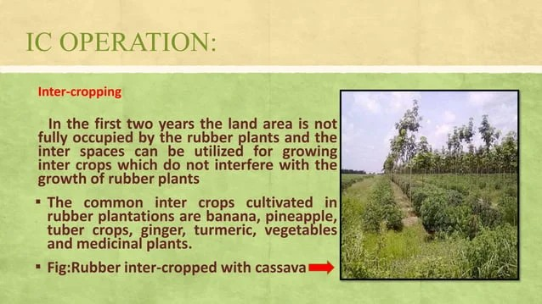
PROPAGATION
Seedlings- on a seedbed then transplant to the farm
Budding
Pruning
Pruning to a height of 2.0-2.5 allows the development of a smooth truck without branches or large scars
Pruning allows the development of a balanced canopy
Intercropping
In the first two years the land area is not fully occupied by the rubber plants and the inter spaces can be utilised for growing inter crops which do not interfere with the growth of rubber plants
The common inter crops include bananas, pineapples, tuber crops, ginger, cassava
Cover cropping
Cover cropping is desirable in sloppy areas as it helps to prevent soil erosion , the practice also helps in enhancing soil fertility, suppress weed growth and controls soil temperature
Any leguminous crop with spreading habit can be grown.

Slide 3
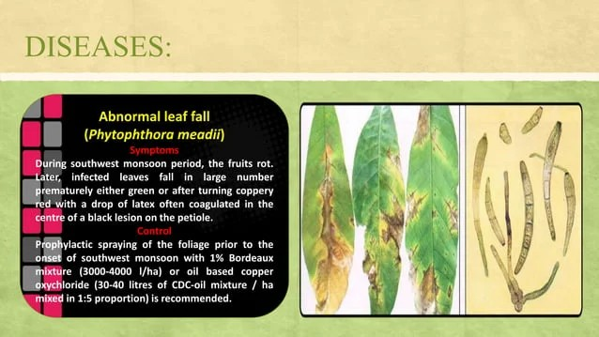
Mulching
The young rubber plants need to be mulched by spreading dry leaves , grass, cuttings and cover crop around the plant .
Weed control
Weeds commonly found in rubber plantations are eupatorium,chromolanae , borreria, lantana,mimosa, mikania, sida,cydon and imperate
Control applying chemicals like ,diuron, simazine, alachor and glyphosphate
Diseases of rubber
Abnormal leaf fall: infected leaves fall in large number prematurely either green or after turning coppery red
Control: spraying of prophylactic the foliage

Slide 4
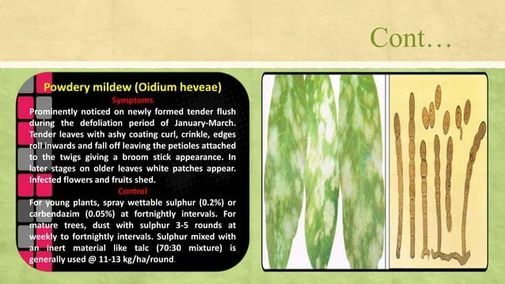
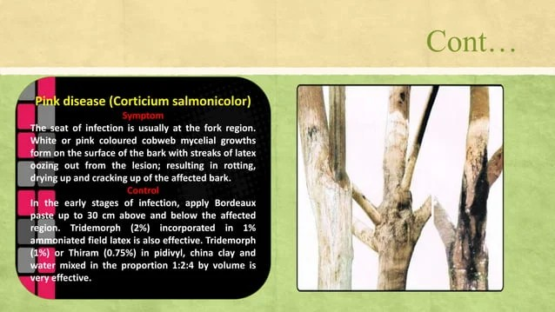
2. Powdery mildew :prominently noticed on newly formed tender flush during the defoliation period of January-march.
Tender leaves with ashy coating curl, crinkle, edges roll inwards and fall off leaving the petioles attached to the twigs giving a broom stick appearance.
Control: for young plants , spray wettable sulphur (0.2%) at fortnightly intervals
3. Pink disease: the seat of infection is usually at the fork region.
White or pink coloured cobweb mycelial growths from on the surface of the bark with streaks of latex oozing out from lesion, resulting in rotting drying up and cracking up of the affected bark.
Control
In the early stages of infection ,
apply Bordeaux paste up to 30 cm
above and below the affected region.

Slide 5
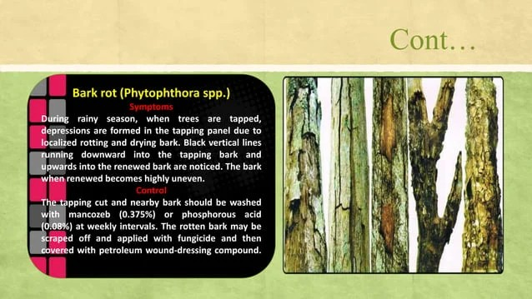
Bark rot; during rainy season , when trees are tapped ,depressions are formed in the tapping panel due to localised rotting and drying bark.
Control: the tapping cut and nearby bark should be washed with phosphorous acid (0.08) at weekly intervals.

Slide 6
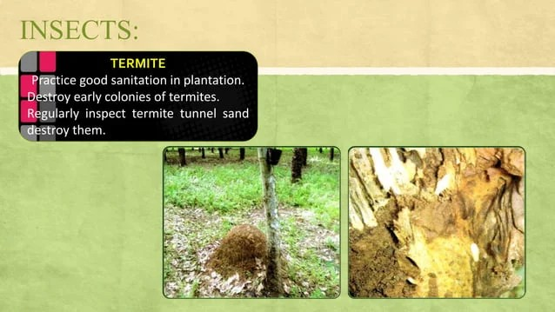
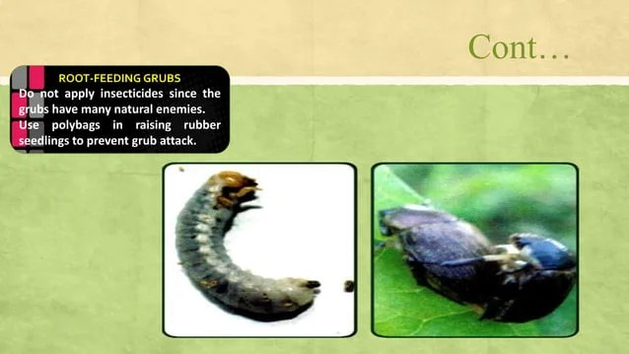
Insects
Termite
Practice good sanitation in plantation
destroy early colonies of termites
Regularly inspect termite tunnel sand and destroy them
Root feeding grubs
Do not apply insecticides since the grubs have many natural enemies
Use polybags in raising rubber seedling to prevent grub attack

Slide 7
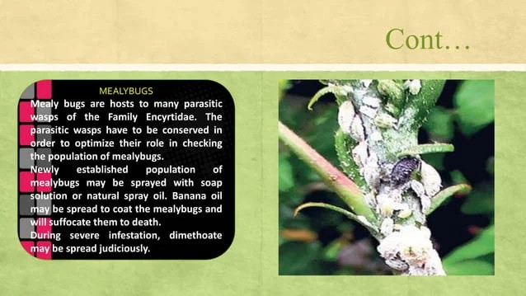
Mealybugs
Mealy bugs are hosts to many parasitic wasps of the family encyrtide
The parasitic wasps have to be conserved in order to optimize their role in checking the population of mealybugs
Newly established population of mealybugs may be sprayed with soap solution to suffocate them to death(insecticidal soap, used to control soft bodied insects)
During severe infestation, dimethoate may be sprayed

Slide 8
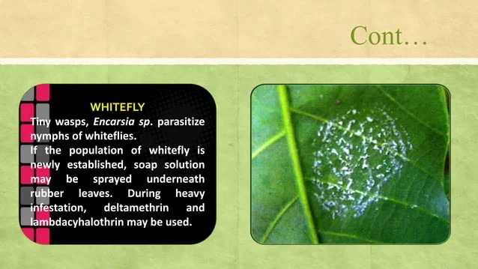
Whitefly
Tiny wasps
If the population of whitefly is newly established, soap solution may be sprayed underneath rubber leaves.
During heavy infestation deltamethrin may be used.
.

Slide 9
RUBBER HARVESTING
Latex is obtained from the bark of the rubber tree by tapping. The technique is also called as ridley.
During the 6th year the trunk is about 50 cm . At this stage the tree is ready for tapping and the yield increases gradually up to 11th year when they will stabilise
The year wise yield parameters considered from the 6th year to the 11th year is 900,1300,1500,1800 and 2000 kg per ha respectively beyond which the yield is the same.
The economic life of rubber is considered as 25 years

Slide 10
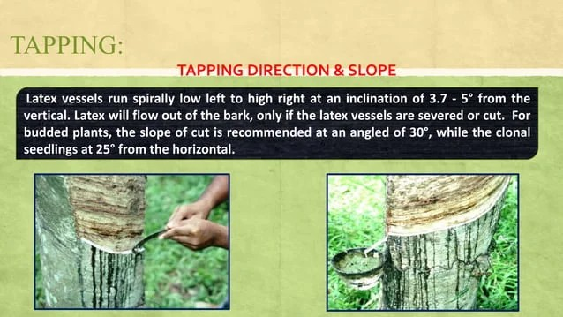
Tapping direction
The slope cut is recommended at an angle of 30 degrees

Slide 11
Processing
The separation of fine sand particles and dirty from the field latex by stirring alone is found impractical due to high viscosity, there is need to dilute with water ,the fluidity of latex increases and separation of fine sand and dirty will be facilitated
Coagulation, the latex is coagulated in metal pans using dilute acid. This pan is filled with a soft cake of coagulated latex.
Rolling , after coagulation the cake of raw rubber is rolled to remove the water and washed to remove the acid
Drying , after rolling the sheet of raw rubber is dried on a rack and smoked (40-60)degrees. Smoking stabillies the rubber and in this form it is sold and trasported to manufactures of rubber products.
End - products include;
Ballons , gloves, condoms ETC

